Slide 1
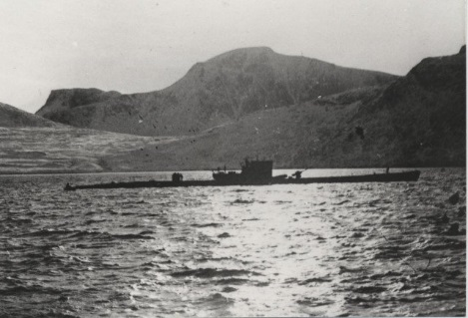
U-boat Weather Reporting
Equipment – Automatic Stations Land/Sea – Manned Stations
Captain Jerry Mason, USN (ret.) VE7YAB
U-boat Archive Website http://uboatarchive.net

Slide 2
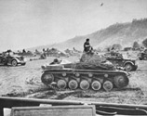
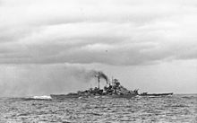
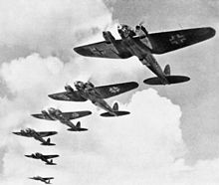
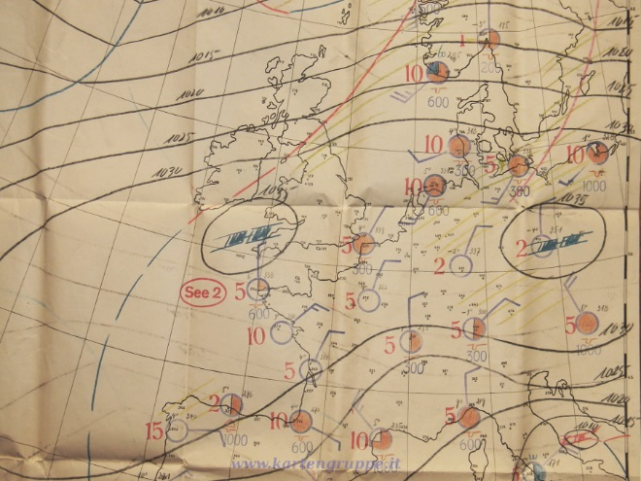
German Meteorological Activities in WWII
Weather forecasting has always been important in military operations
Blitzkrieg France
Bismarck breakout
Battle of Britain
European weather forms in the Arctic moving west to east
Greenland, Jan Mayen and Spitzbergen were ideal reporting locations
At first neutral Denmark and Norway transmitted weather reports in international code
Cooperation ceased after the invasion of Denmark and Norway in April 1940

Slide 3
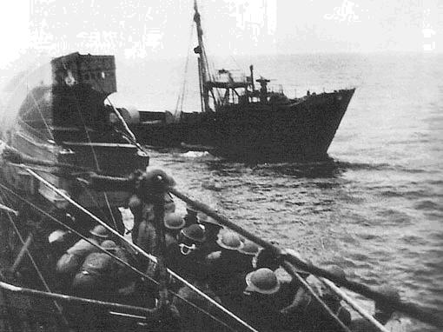
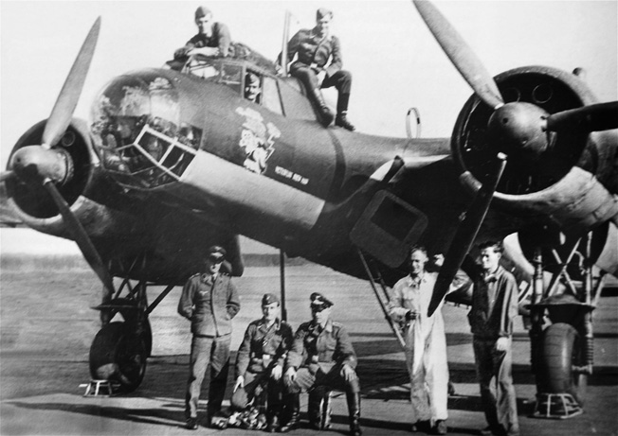
German Meteorological Activities in WWII
Initially weather reporting was done by weather trawlers – with disastrous consequences
Two U-boats were continually assigned from August 1940 to January 1941
The Plan:
Manned stations provided weather reports from remote sites during winter months
Automatic weather stations on land and sea covered the summer months
U-boats ferried personnel to and from manned weather stations, escorted weather ships and deployed automatic weather stations
German Air Force performed weather reconnaissance with aircraft also with manned and automatic stations
HMS Tatar seized Lauenburg 28 June 1941
Weather Reconnaissance DO 17 1940

Slide 4
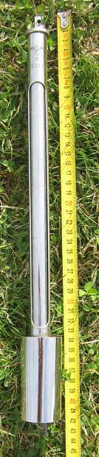
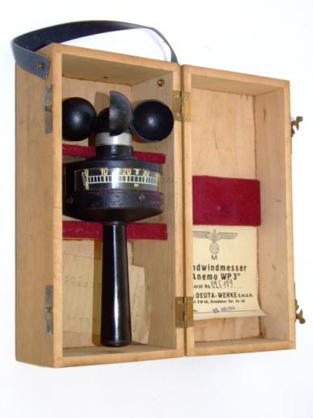
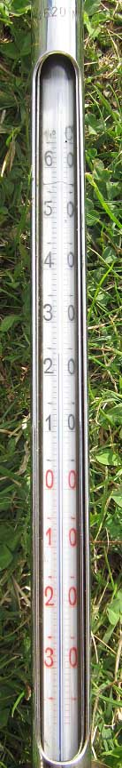
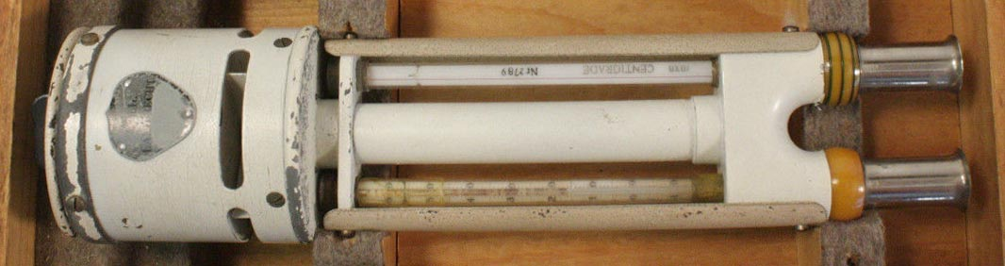
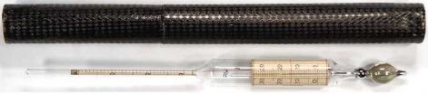
U-boat Weather Equipment
Thermometers
Hand anemometer
Aspirated psychrometer
Hydrometer/Thermometer

Slide 5
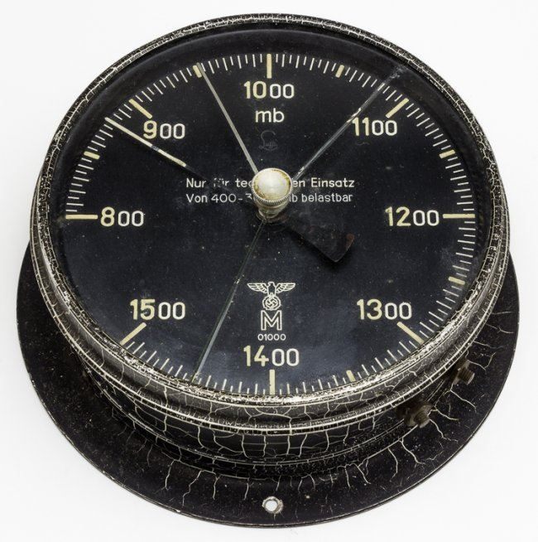
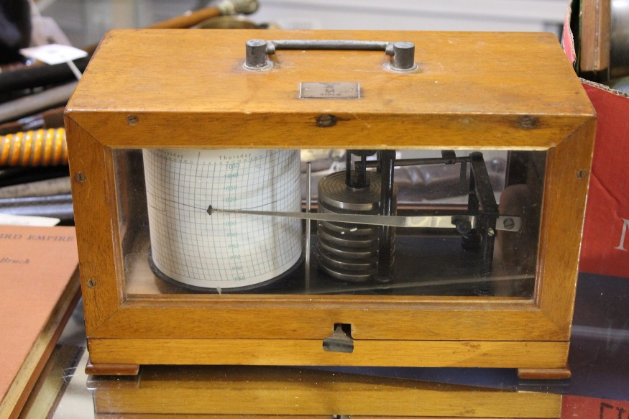
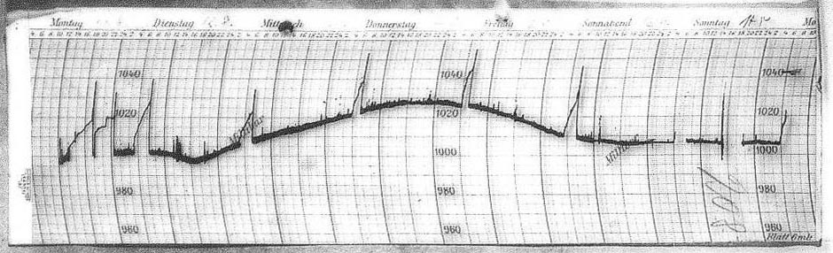
U-boat Weather Equipment
Barometer Both aneroid type
Mounted in the control room
Usable from 400 – 3000 mb
Second in the Captain’s cabin
Barograph
Mounted in the radio room
Strips were included with the war diary

Slide 6
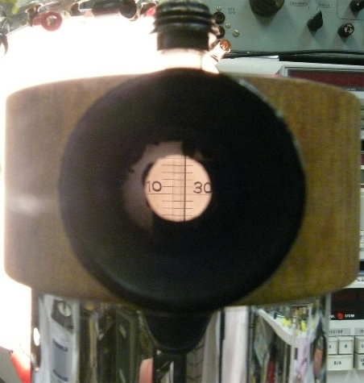
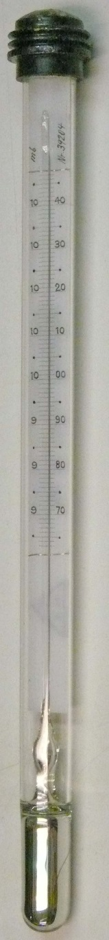
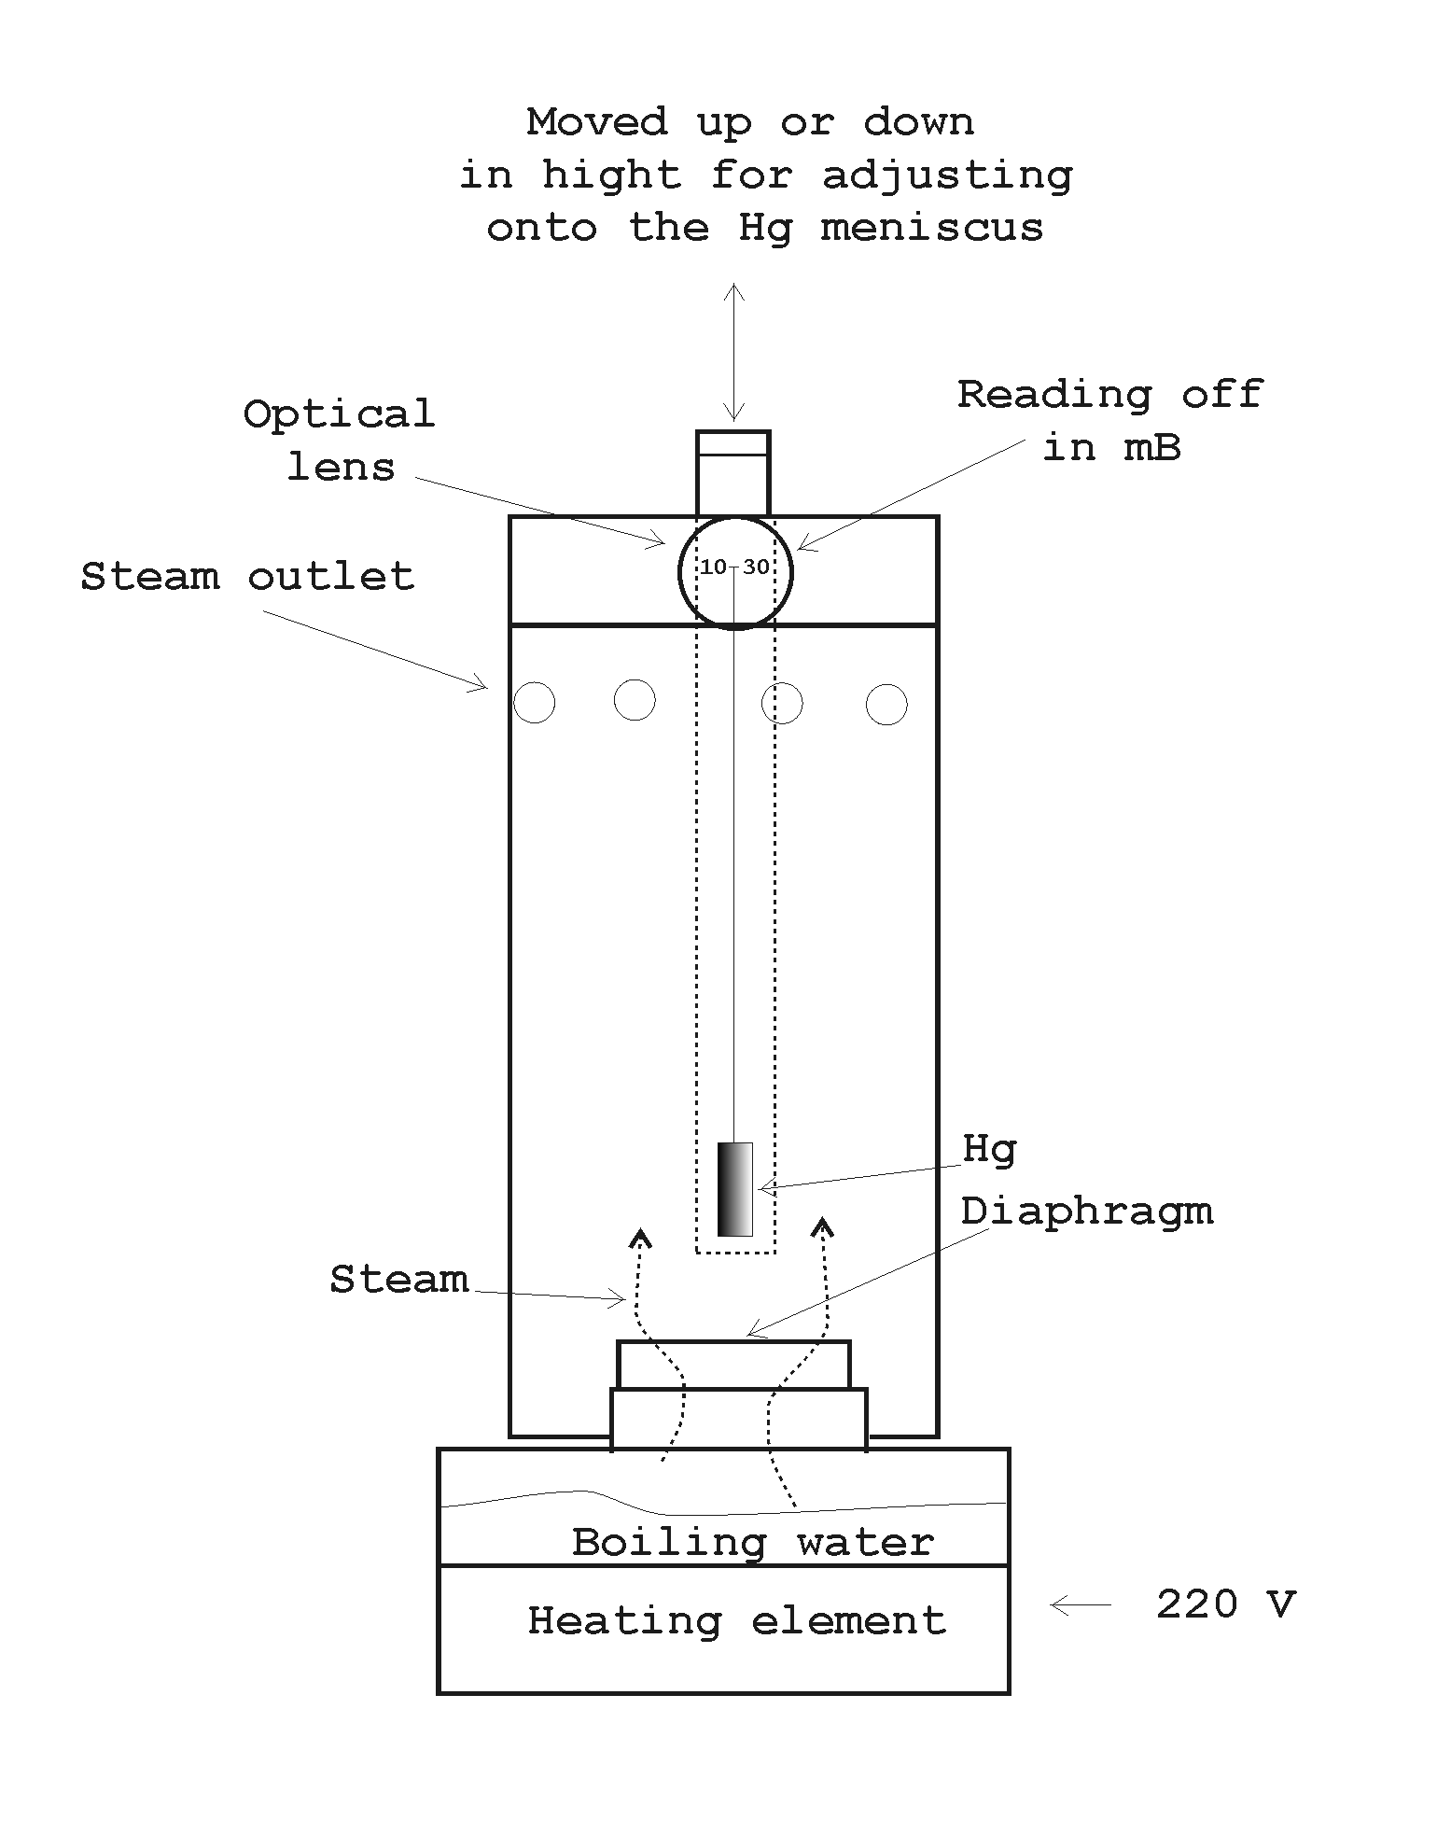
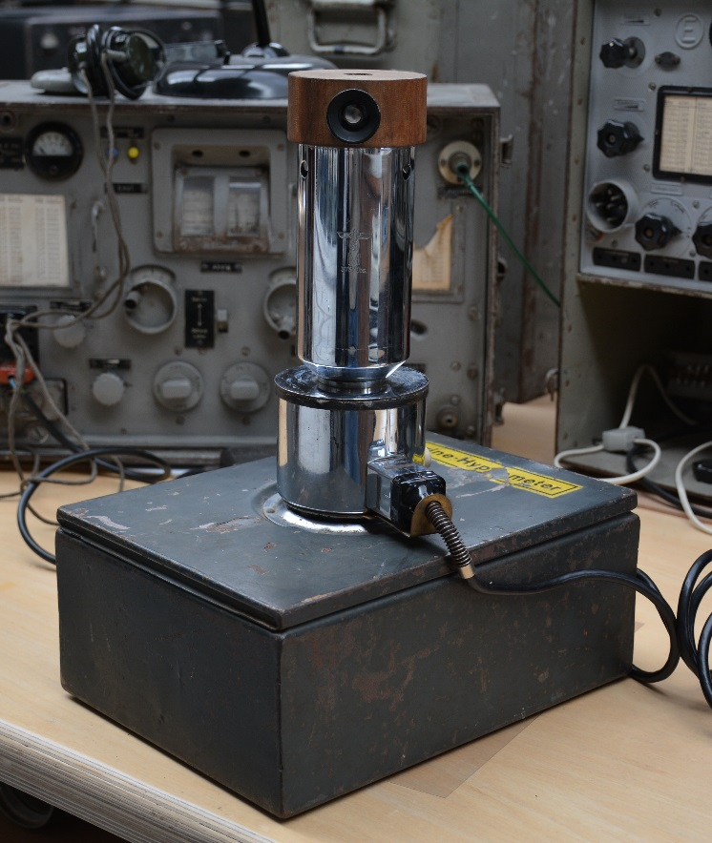
U-boat Weather Equipment
Hypsometer
Used to calibrate the aneroid barometers
Measured temperature at which distilled water boiled
Read directly in millibars

Slide 7

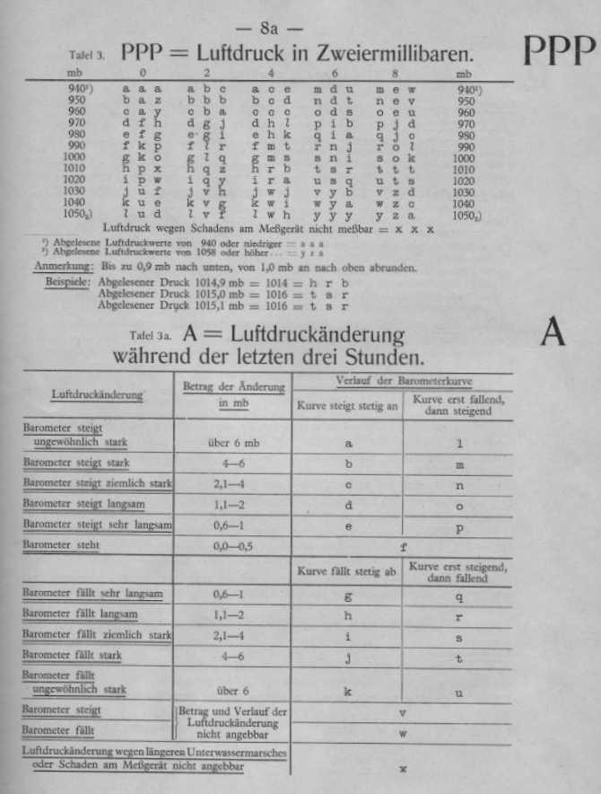
Short Signal Weather Report
Format
Normal weather
S_{p} R BB PPP A C W Z V DDD K L T M G UUU
Ice weather
S_{p} R B B PPP A C W Z V DDD K L T M G E UUU
≈ 24 letters sent in ≈ 10 seconds
S_{p} = Message key
R = Sea area (grid map) and change in wind direction (last 3 hours)
BB = ID letters for position
PPP = Barometric pressure
A = Pressure change (last 3 hours)
C = Clouds
W = Sky covering and rain fall
Z = Weather change (last 12 hours)
V = Horizontal visibility and fog conditions
DDD = Wind direction and strength
K = Changes in wind strength, swell and height
L = Length and direction of the swell
T = Air temperature in degrees Celsius
M = Difference between air and water temp.
G = Time of observation in hours in DGZ
E = Ice conditions
UUU = Signature of U-boat

Slide 8
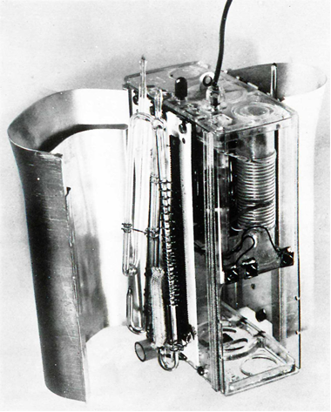
Radiosonde
Developed by and for the German Navy 1936 – 1939
Wilhelmshaven Naval Meteorological Observatory
Design based on control of transmitter frequency by meteorological sensors
Sensing elements contain fixed calibration points that cause abrupt frequency changes
All electronic – no mechanical error
Measured temperature, pressure, humidity
Transmitted via HF radio on two frequencies
Designed for transport, storage and use from ships and expeditions

Slide 9
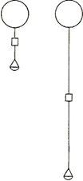
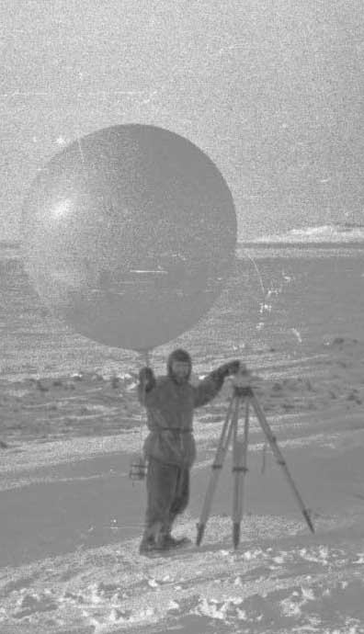
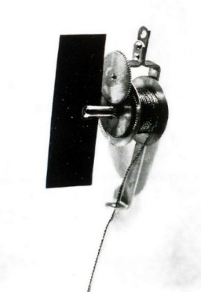
Radiosonde Launch
Hydrogen filled balloon 1.5 - 2 meters in diameter
U-boats carried hydrogen in cylinders, manned stations generated hydrogen by mixing Aluminium and H₂SO₄
Two antennas and a parachute
At launch antennas are coiled up, they extend automatically after launch
Rate of ascent = 300 meters/minute
Tracked with a theodolite for wind speed
Reached 17 km in about 90 minutes
Antenna extension mechanism with coiled antenna and air brake

Slide 10
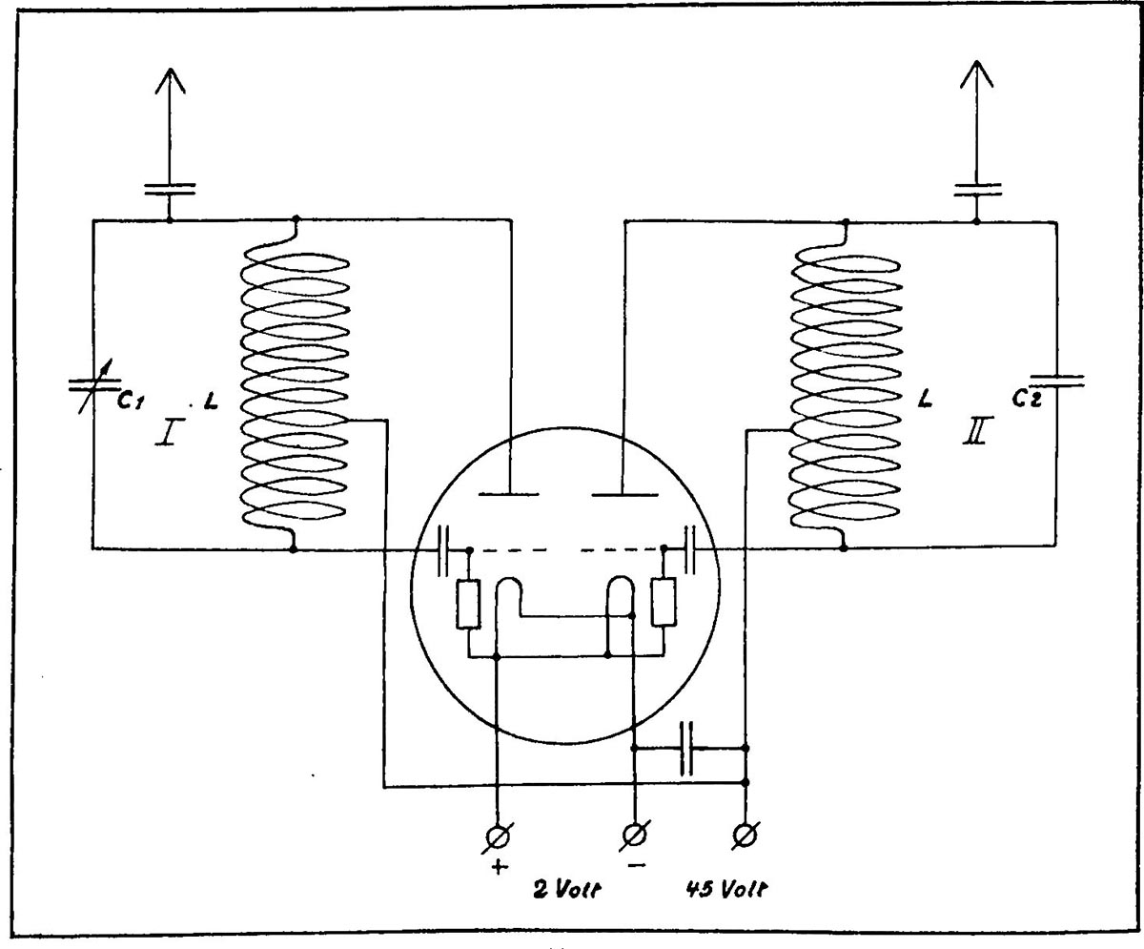
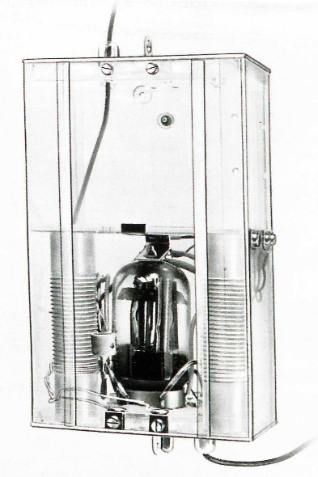
Radiosonde Circuitry
Two shortwave transmitters in one unit
Each contained as oscillator an independent audio circuit
Circuits differ only by their capacitors
C1 100 pF temperature sensitive
C2 60 pF fixed
Special double grid tube
  Grid heater 2 V (dry Rulag battery)
  Anode voltage 45 V (wet Thor Fill battery)
Transmitter I air temperature
  8,000 kHz 37.5 meters (room temperature)
  1°C = change of 2.7 kHz
Transmitter II air pressure and humidity
  10,400 kHz 28.8 meters
Open antenna circuits - length = λ / 2.2
  - Total antenna length 35 meters

Slide 11
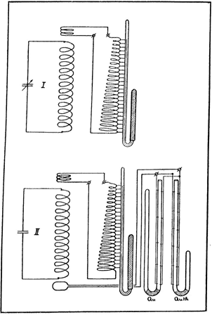
Radiosonde Sensors
Naval probe contains 5 meteorological sensors
2 contact thermometers
2 pressure gauges
temperature sensitive capacitor +27 to -58°C
Dry bulb contact thermometer (range +27C to -60°C)
served to calibrate the capacitor
30 platinum contacts divide the range in 3°C steps
mercury-thallium – freezing point -60°C
Wet bulb contact thermometer (range +27C to -35°C)
determine humidity by psychrometric method
same construction mercury filled
braided sock kept moist with distilled water
Pressure gauges
1000 to 450 mb mercury filled
600 to 80 mb mercury-thallium filled
5/6 contacts provide a total of 22 points

Slide 12
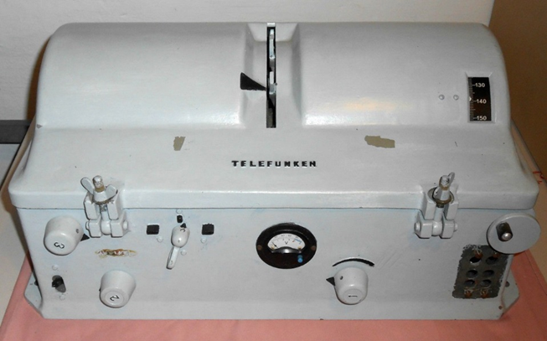
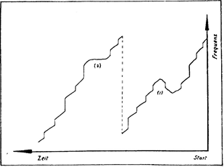
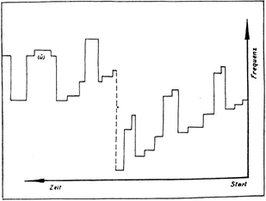
Radiosonde Interpretation
Two E381S receivers were used to monitor radiosonde ascents
Operators adjusted tuning to match the tones from the probe
Tuning knob mechanically coupled to a wax paper recorder
Dry temperature recording
With frequency jumps of the dry thermometer and continuous measurement of the capacitor
(1) inversion, (2) isothermal conditions.
Wet thermometer and pressure component recording
Pressure component jumps are 10 x the size and in a different direction than the wet temperature jumps
(Ü) overlap of the ranges of the two pressure components.

Slide 13

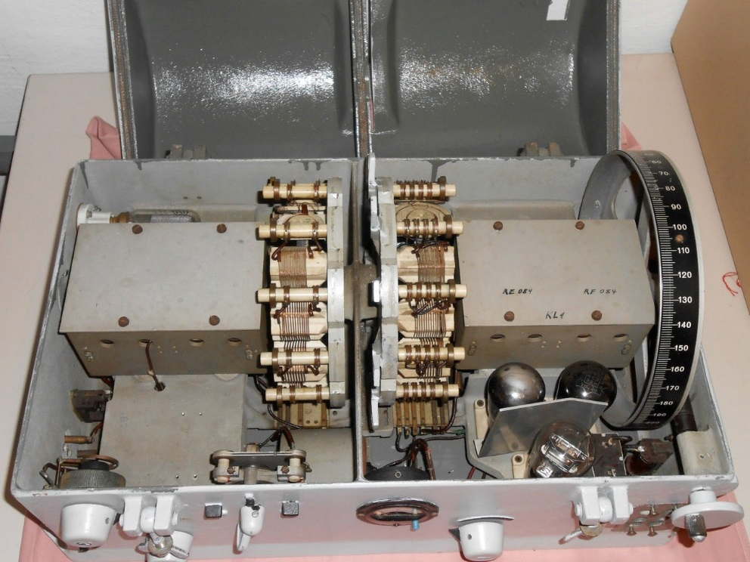
Telefunken E381S Receiver
Size: 57 cm wide x 27 cm high x 35 cm deep
Weight: 20 kg
Reception principle: TRF with reaction
Tuned circuits 2 AM circuits
Frequency Range: 14.6 kHz to 20 MHz
Valve lineup: RES094 (RF), 3 x RE084 (detector, audio and output stages)
Power: +4V 0.35A, +100V 20 mA
Year: 1933

Slide 14
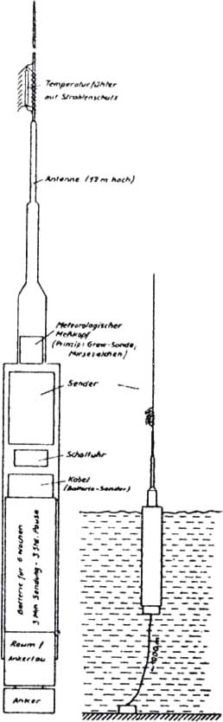
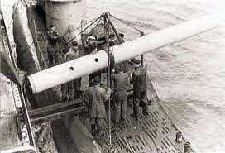
Weather Radio Sea WFS
Developed for the Naval Weather Service by Siemens and Schukert
Designed and tested from 1940 – 40 ordered in 1942
7 meter long x 52 cm diameter steel cylinder – 12 meter antenna
Weight 1500 kg Anchor up to depth 300 meters
Air pressure (aneroid barometer) and temperature (helix bimetallic)
Electrically wound timer – sampled 4 times/day
Encrypted into Morse code transmitted 10 times on HF in 60-80 seconds
Designed for endurance of 10 weeks
WFS 106 being loaded aboard U-703 in Trondheim 18 July 1943

Slide 15
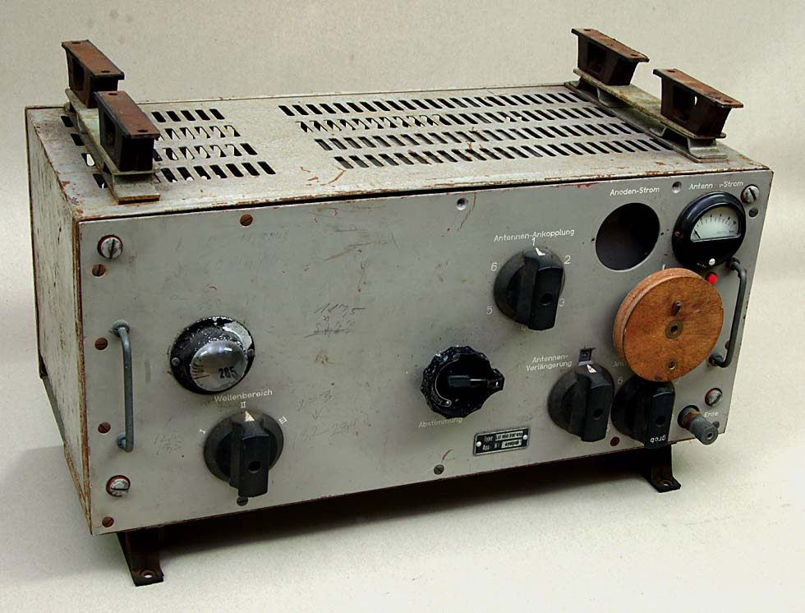
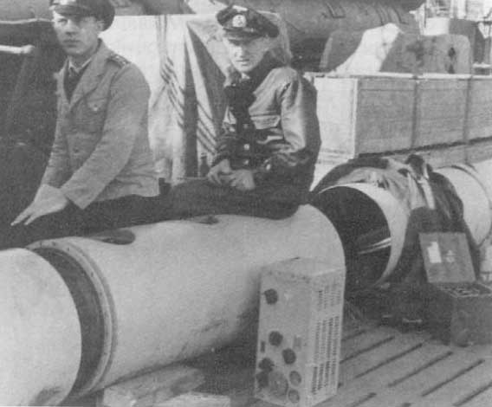
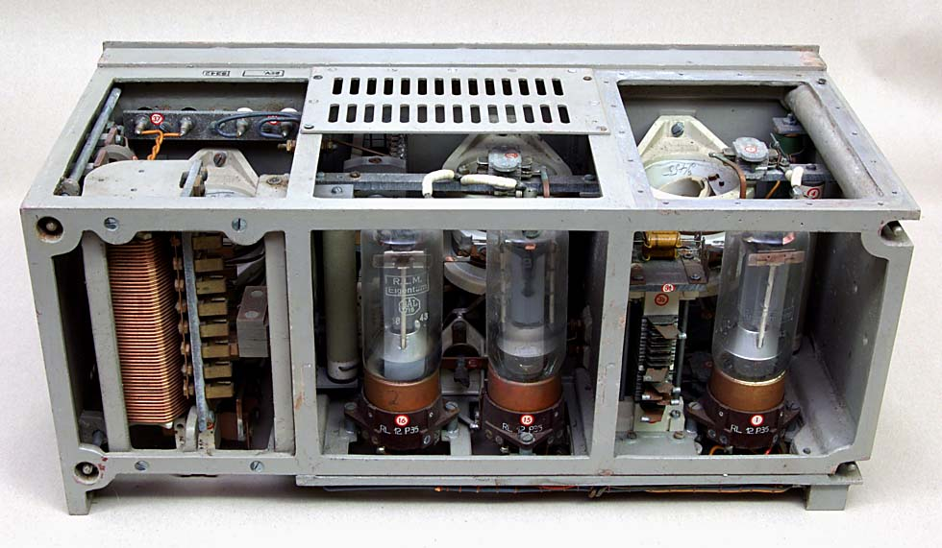
Weather Radio Sea WFS
Lo150FK41a (3-12 MHz) 150 Watt transmitter
Based on the Lo40K39 40 watt transmitter
150 watt radiated power achieved by replacing both RL 12P35 tubes with RS 391 tubes and raising anode voltage from 600 to 900 volts
Sealed lead–acid batteries – anode voltage 900 Volts
Nickel-cadmium batteries – tube heating
WFS 133 “Ernst” during loading from supply ship "Kärnten“ to U-703 on 11 September 1944
The boat was lost before the buoy was deployed

Slide 16
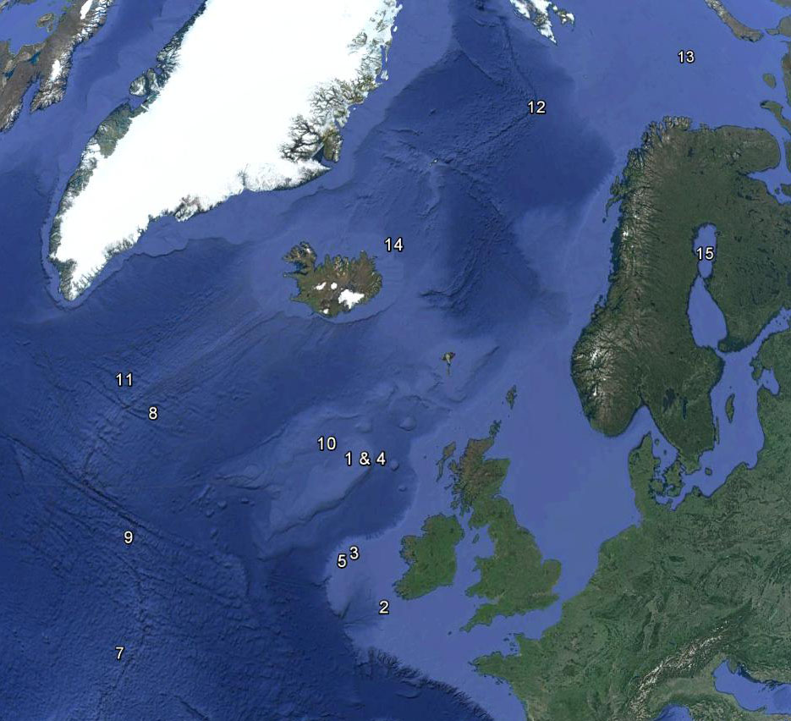
Weather Radio Sea WFS
WFS 2 29.09.40 U-103*
WFS 33 07.01.42 U-156
WFS 22 08.01.42 U-156
WFS B 28.04.42 U-159
WFS A 29.04.42 U-159
WFS 24.08.42 U-516
WFS 30.08.42 U-516
WFS 31.10.42 U-519
WFS 104 08.11.42 U-519
WFS 112 29.04.43 U-531
WFS 26.06.43 U-194**
WFS 106 23.07.43 U-703
WFS 107 27.07.43 U-703
WFS 133 10.09.44 U-703**
WFS 18.11.44 U-1165
* Operational testing
** U-boat lost before deployment
Buoys stored in over deck torpedo canisters – anchors in the over deck
Upper and lower antenna parts in the torpedo room up through the torpedo loading hatch
Torpedo crane used to move heavy components – Limit: Wind 2, Swell 2, Sea State 2
Assembly and deployment took about 1.5 hours during which the boat could not dive

Slide 17
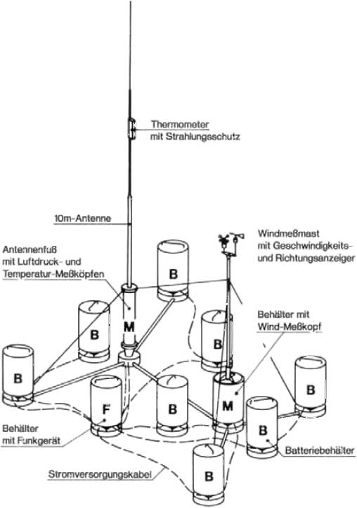
Weather Radio Land WFL
Same components as WFS
20 ordered in 1942
1 meter high steel pots 52 cm in diameter
Weighed no more than 100 kg each
Pot M – wind measurement sensors and nickel-cadmium batteries
Pot M – 10 meter antenna with temperature and air pressure sensors
Pot F – Lo150FK41a 150 Watt transmitter
Pot B – Sealed lead–acid batteries number depended on desired endurance
Air pressure, temperature, wind strength and direction were sampled 4 times/day
Encrypted in Morse code transmitted 10 times in up to 120 seconds
Designed for an endurance of 10 – 24 weeks

Slide 18
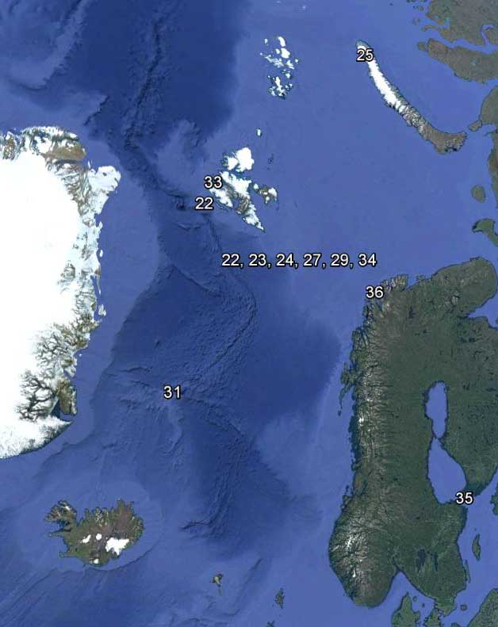
Weather Radio Land WFL
WFL Station Date Boat
21 “Gustav” Spitzbergen 29.09.42 U-377
22 “Edwin” Bäreninsel 01.12.42 U-657
23 “Edwin II” Bäreninsel 18.03.42 WBS 2
24 “Robert” Bäreninsel 09.07.43 U-629
25 “Gerhard” Nowaja Semlja 22.08.43 U-703
26 “Kurt” Labrador 23.10.43 U-537
27 “Dietrich” Bäreninsel 07.09.43 U-355
-- -- -- --
“Christian” Bäreninsel 06.12.43 U-713
“Herbert” Labrador -- .09.44 U-867*
“Walter” Jan Mayen 25.09.44 U-992
“Erich” Nowaja Semlja 15.10.44 U-387
“Edwin III” Spitzbergen 30.06.44 U-737
“Hermann” Bäreninsel 17.06.44 U-737
“Landjäger” Åland Insel 22.11.44 U-1165
“Wilhelm” Magerøya 11.11.44 U-1163
* Boat lost before deployment

Slide 19
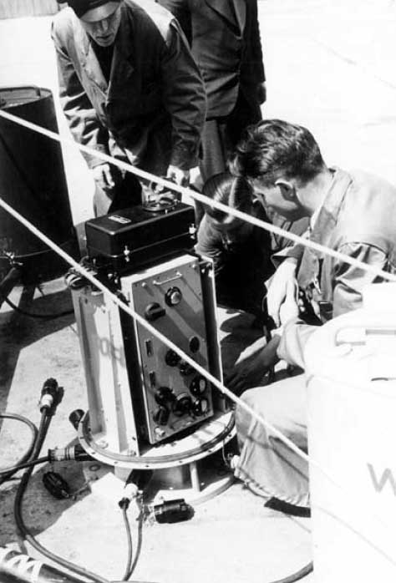
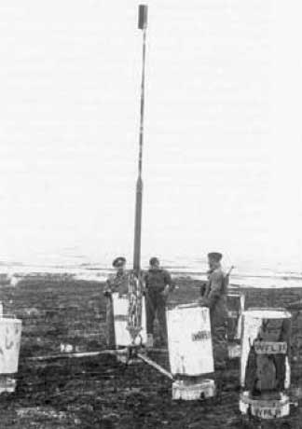
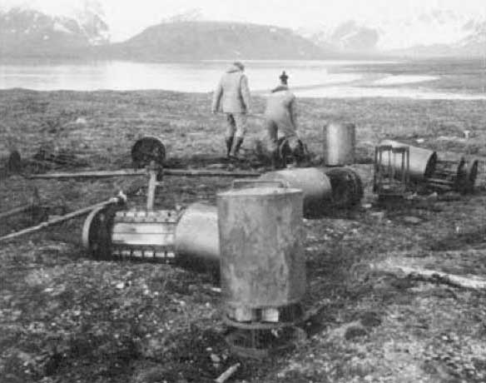
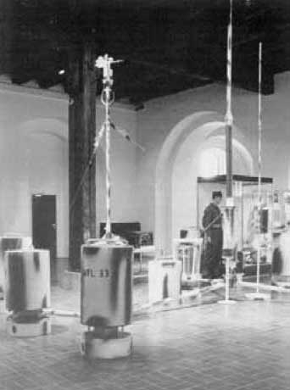
Weather Radio Land WFL
WFL 33 “Edwin III” has an interesting story
Deployed 1 July 1944 on North Spitzbergen by U-737
Last weather data received in May 1945 (11 months)
Discovered in 1982 - salvaged in 1984
Restored and exhibited in Forsvarsmuseum in Oslo

Slide 20
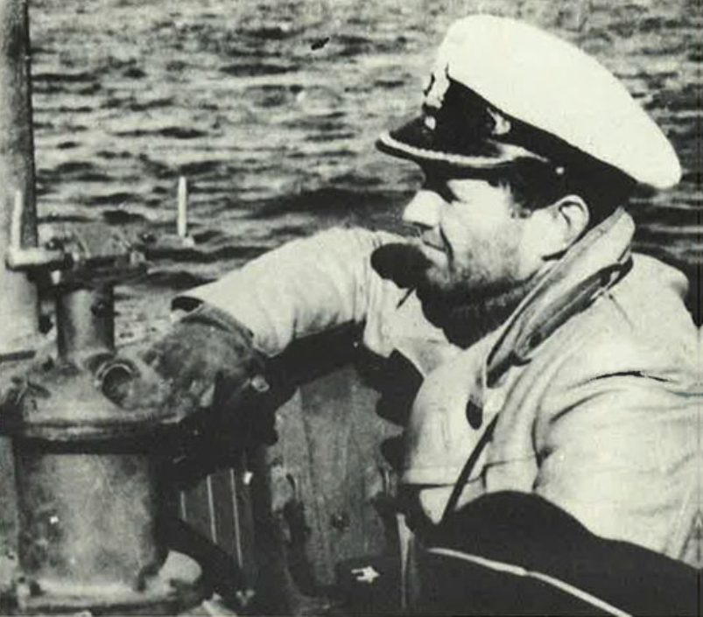
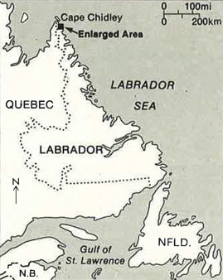
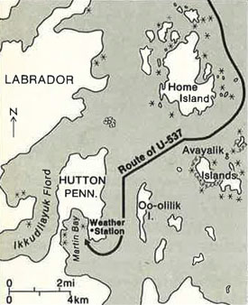
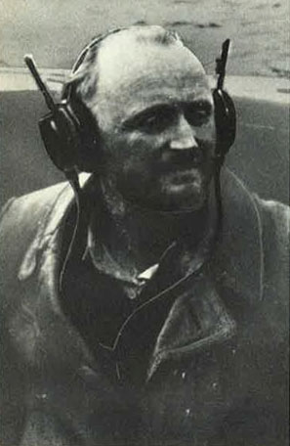
WFL 26 “Kurt” U-537
U-537 Type IXC Kapitänleutnant Peter Schrewe
Departed Bergen on its first war patrol 30 September 1943
Two meteorologists: Dr. Kurt Sommermeyer & Walter Hildebrant
Suffered damage from heavy seas during Atlantic crossing
Arrived at dawn 22 October off the Labrador coast

Slide 21
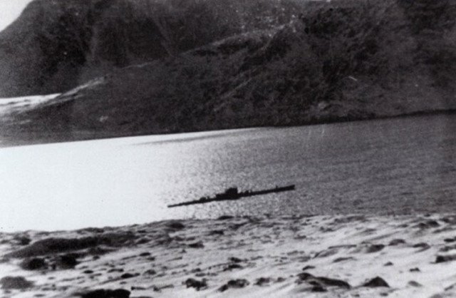
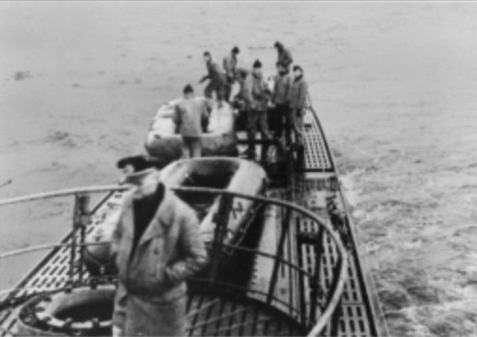
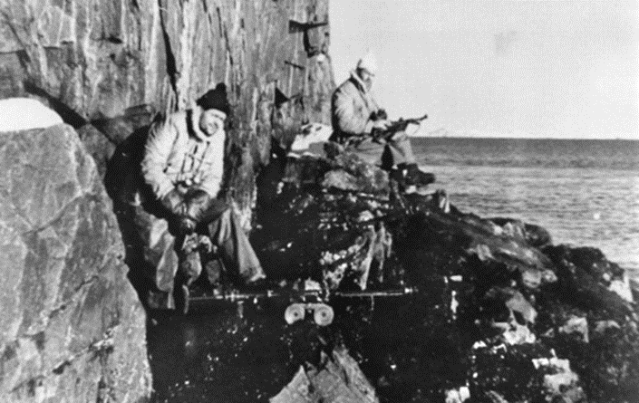
WFL 26 “Kurt” U-537
U-537 anchored in Martin Bay at 12:00 local
Dr. Sommermeyer quickly identified the site
The meteorologists & ten sailors worked to put the station ashore by rubber boat over the beach 50 meters up a hill and 400 meters inland
Armed lookouts posted while other crew members repaired storm damage

Slide 22



WFL 26 “Kurt” U-537
Working throughout the night the station was completed about 12:00 local the next day
To disguise the station empty US cigarette packs were strewn about and one canister was marked “Canadian Metor. Service”
The boat waited until the first transmission was heard that evening then put to sea
U-537 conducted an unsuccessful patrol off Newfoundland arriving in Lorient 8 December
The boat’s next patrol took it to Batavia (Jakarta) where it was lost on 10 November 1944

Slide 23


WFL 26 “Kurt” U-537
Forgotten until 1977 Kurt was discovered by geomorphologist Peter Johnson
Retired Siemens engineer Franz Selinger contacted Canadian National Defense Historian W.A.B. Douglas
Douglas went to the site in 1981 and recovered the station
Kurt is now exhibited at the Canadian War Museum in Ottawa
Above: U-537 anchored in Martin Bay
Below: Kurt during its recovery

Slide 24

Manned Weather Stations
Navy deployed manned weather stations to the Arctic in the winters of 1942-1945
Reasonably safe from October until spring pack ice allowed enemy access in about June
Air Force manned stations had smaller crews (2-4 men), established and supplied by aircraft
Navy stations were larger (8-12 men), self sufficient in prefabricated huts, adequate supplies to overwinter, equipped with meteorological equipment and radiosondes, radio gear and weapons for self defense (1800 items, 1220 cases of provisions, 80,000 kg)
Crews were totally dependent on themselves during the dark winter months
Radio links with the Navy Radio Station Tromsö was their only contact with the outside world
At right: Weather station Knospe on Spitzbergen 1941/2

Slide 25

Manned Weather Stations
“Sachsen” Denmark Strait 1940
“Sachsen” Jan Mayen area 41
“Lauenberg” Jan Mayen area 41†
“Bansö” West Spitzbergen 41/42*
“Knospe” West Spitzbergen 41/42
“Nussbaum” West Spitzbergen 41/42
“Holzauge” East Greenland 42/43
“Kreuzritter” West Spitzbergen 43/44
“Bassgeiger” East Greenland 43/44
“Hessen” North Atlantic 44***
“Schatzgräber” Franz Josef land 43/44
“Svartisen” Hopen Island 43/44*
“Edelweiss” East Greenland 44††
“Edelweis II” East Greenland 44††
“Zugvogel” North Atlantic 44/45†††
“Hellhus” Hopen Island 44/45*
“Landvik” South Spitzbergen 44/45**
“Taaget” Bären Island 44/45**
“Haudegen” Nordaustlandet 44/45
† Lost to British Navy, †† Lost to US Coast Guard, ††† Lost unknown causes
* Luftwaffe station, ** Abwehr station, *** Did not reach station

Slide 26

“Haudegen” Station
“Haudegen” (Swashbuckler) established on Nordaustlandet on Spitzbergen
September 1944 to September 1945 – last unit of the German Armed Forced to surrender
12 men: Leader Dr. Dege, 3 meteorologists, 6 radioman and two sailors
Dr. Dege, 34 yo geomorphologist, had made three research trips to Spitzbergen in 1935, 1936 & 1938
Dr. Dege was keen to carry out an extensive scientific program
Based on Dr. Dege’s experience “Haudegen” was established in Wirdiebucht in Rijpfjord
They recorded eight daily meteorological observations - encrypted until the German surrender
Afterwards reports were transmitted in the clear in the international meteorological key and Nordaustlandet was intensively studied

Slide 27


“Haudegen” Station
575 nm north of Hammerfest
Main station
Evasion camps

Slide 28



“Haudegen” Timeline
1944
27 Aug K.J. Busch and U-307 sort supplies in Ramsfjorden
9 Sep K.J. Busch and U-307 depart Norway for Nordaustlandet
14 Sep Offload & construction of the main station
17 Sep U-307 set off to establish 3 evasion camps
26 Sep Radio station ready to operate
27 Sep K.J. Busch and U-307 depart – weather reports begin
18 Oct Sun disappears
1945 Average temp. -10°C
1 Mar Sun reappears January low of -33.6°C
3 Mar Mines installed July high of +9.6°C
7 May Germany surrenders
8 May Mines detonated - weather reports as Station “X02”
15 May First expedition to Camp A1
15 Jun Last expedition to Camp A2
3 Sep Station surrenders
5 Sep Last weather report sent
Eight daily observations, 140 radiosondes, 1222 weather reports

Slide 29



“Haudegen” Radio Gear
Two generators (started 3-4 times a day to transmit) and batteries
Adaptor SL 02/2R – converted DC to 800 V AC
Main transmitter: Lorenz Lo40K39 (3-16.7 MHz) raised to 70 Watts
Main receiver: E381S (5 kHz-20 MHz in 10 bands)
Three such sets: one in the station, one reserve, one Camp A1
Radione R2 broadcast receiver with turntable and speakers

Slide 30

Lorenz Lo40K39 Transmitter
Size: 55 cm wide x 60 cm high x 30 cm deep
Weight: Tx. 35.4 kg
+ Pw. 38.5 kg = 73.9 kg
Power: 40 W
Frequency Range: 3-16.7 MHz
Valve lineup: 3 RL12P35
Power: 220 V AC
Year: 1937

Slide 31



“Haudegen” Radio Gear
Main antenna built between two guy-wire masts aligned with the remote radio station in Tromsö
Two auxiliary antennas for the Radione receiver and the Radiosonde receiver
Emergency radio station at Camp A2
Telefunken Stat. 272 Bs 15W Naval Landing Station (transceiver) , 3000 – 5000 kHz
Powered by a treadmill Spez.955 Bs

Slide 32
Video Placeholder

Slide 33



“Haudegen” Today
After 3 months in captivity Dr. Dege and his men were sent home
The men tried to meet every year for a reunion – complicated by the Cold War
Dr. Dege died in 1972 – two men in their 90’s survive today
Dr. Dege’s diary was found by son Dr. Eckart Dege in 1985
The station is still standing, a new roof was installed in 2015 - the site is protected

Slide 34


The End
Learn more about U-boats including radio equipment and the war diaries of boats that supported weather reporting at:
http://uboatarchive.net
Download the presentation at:
http://uboatarchive.net/Presentations/Presentations.htm
Read about the Haudegen station in
War North of 80 – The last German Weather Station of World War II – by Dr. Wilhelm Dege

